Slide 2
3D blade model updating by coupling HAWC2 and ABAQUS
Maria Luz Castilla Mena (s212601@dtu.dk)
Notes:
Hi, I am Maria and I am going to present my master thesis topic: Evolution of blade cracks with wind turbine simulation tolos (this is a provisional titile, it needs to be discussed)

Slide 3
INDEX
From last meeting
Progress of the project
For the next meeting

Slide 4
From last meeting
Run .htc file with wsp at hub height and power shear with alpha = 0.3
Write documentation about wind profiles

Slide 5

Progress of the project
Run .htc file with wsp at hub height and power shear with alpha = 0.3
Challenge: profiles don’t match

Slide 6
Results

Slide 7
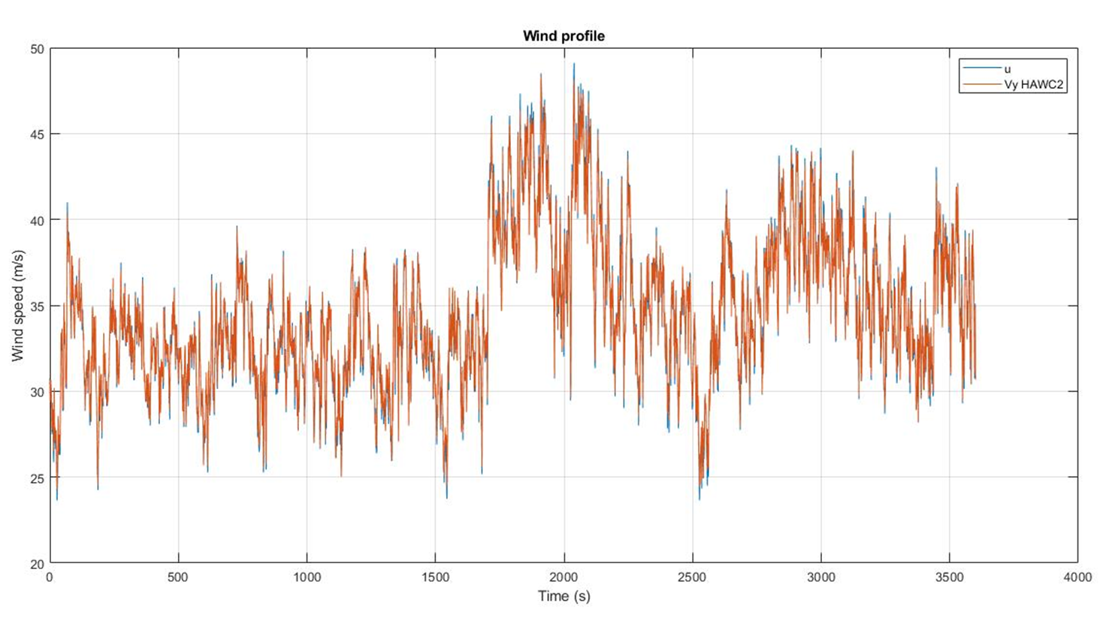
Wsp = 34.55 m/s at a height = 40m

Slide 8
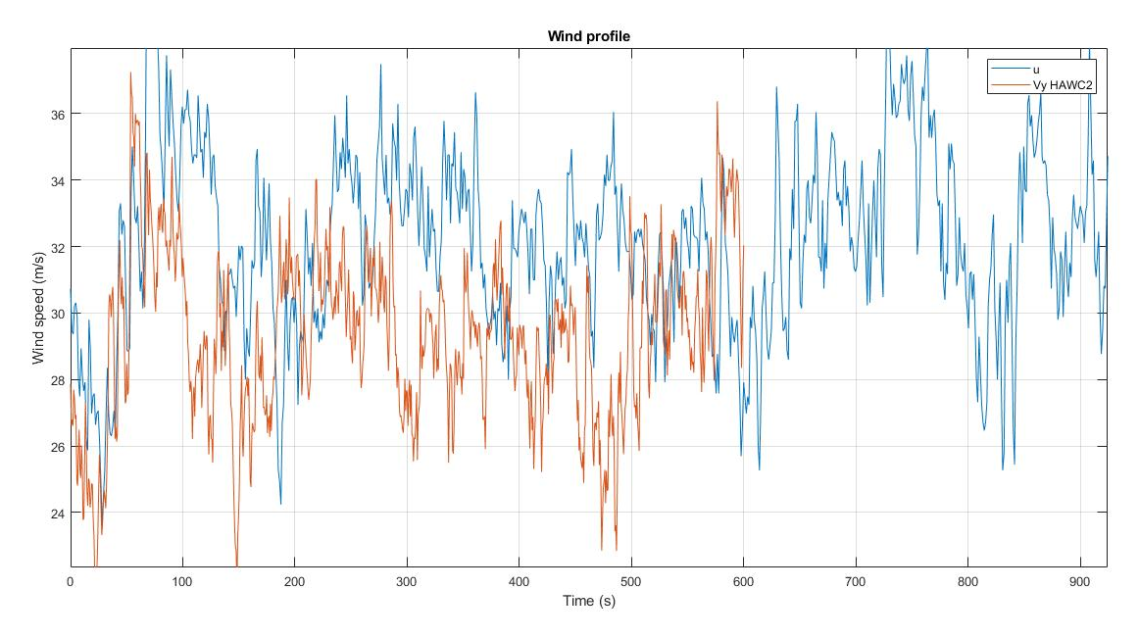
Wsp = 43.617 m/s at hub height (= 120m)

Slide 9
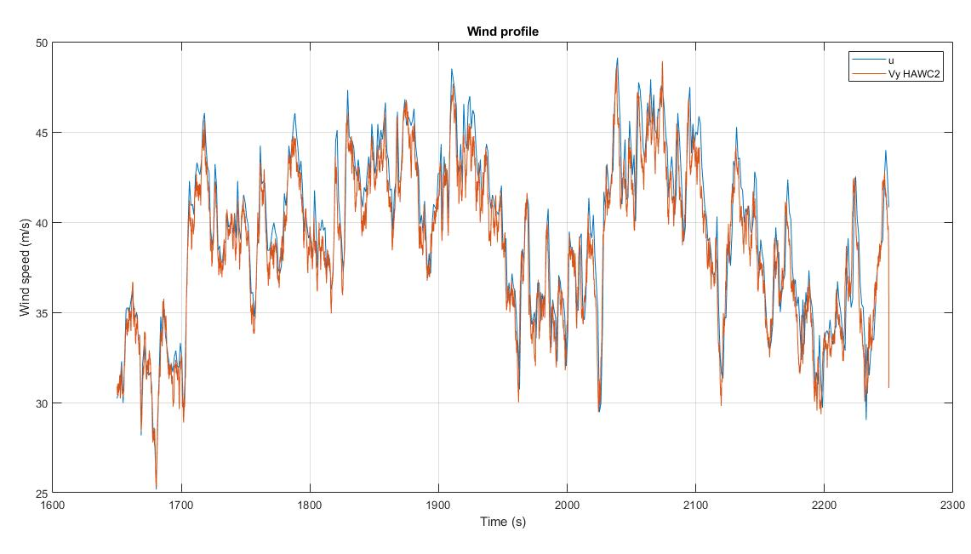
Peak of 600s, Nx = 8192

Slide 10
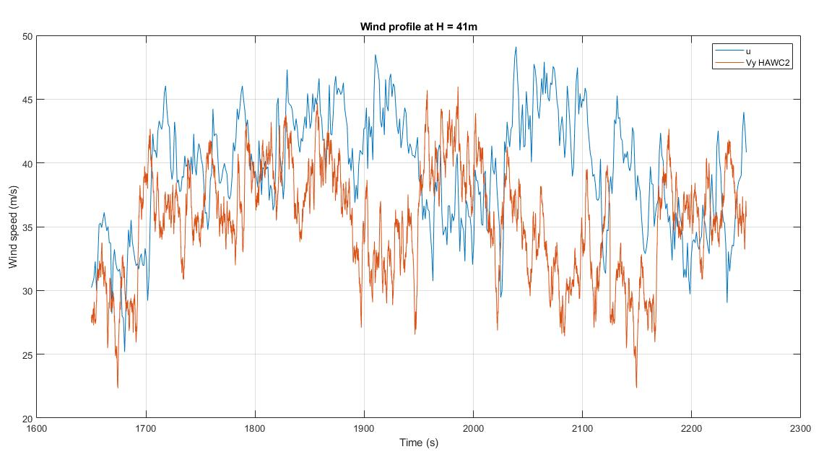
Peak of 600s, Nx = 8192, with shear

Slide 11
Problems
Time is not linear
Post-processing problem?
Run wind step case .htc file and check results
They match

Slide 12
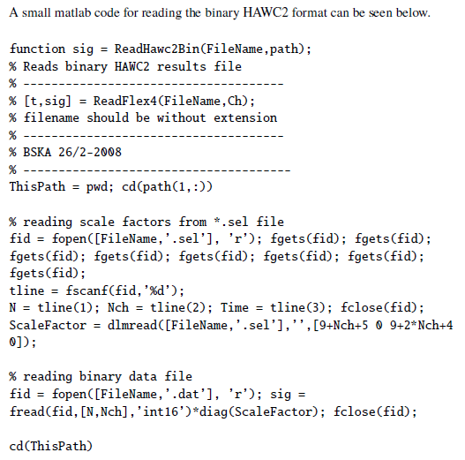
Post-processing

Slide 13
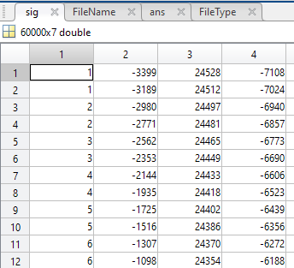
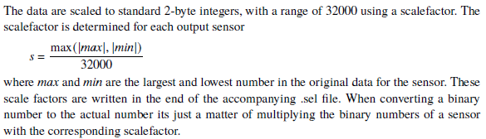
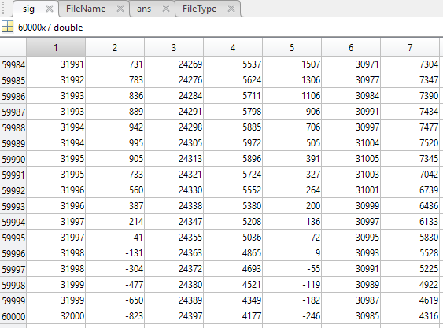




Slide 14
For next meeting…

Slide 15
For the next meeting
Post-processing tool
Write documentation
Suggestions?

